Slide 1
CS 457
Module 2 Python

Slide 2
Agenda
Administration
PHP Midterm announcements
Python
Assignment 1

Slide 3
Administration
PHP midterm 1
Some questions have a formatting issue, code does not show up
Those questions will be given fullpoints.
If you have any issues during the exam, take a screen shot and send me the documentation.
Test will be graded soon

Slide 4
Administration
Assignment 1
I am preparing a git repository for you to turn in your code. Currently we are testing the server. The server should be available next class.

Slide 5

Module 2 – Python
The next scripting language we will cover is Python

Slide 6
Python
Python is a high-level, interpreted, interactive and object-oriented scripting language.
Interpreted – processed at runtime by the interpreter no need to compile your program before running
Object-Oriented – encapsulate code within objects
Interactive – has a shell propt you can interact with
Python has an elegant syntax, with many natural language features
Notes:
Python is Interpreted: This means that it is processed at runtime by the interpreter and you do not need to compile your program before executing it. This is similar to PERL and PHP.
Python is Interactive: This means that you can actually sit at a Python prompt and interact with the interpreter directly to write your programs.
Python is Object-Oriented: This means that Python supports Object-Oriented style or technique of programming that encapsulates code within objects.
Python is Beginner's Language: Python is a great language for the beginner programmers and supports the development of a wide range of applications from simple text processing to WWW browsers to games.

Slide 7
Python: History
Developed by Guido van Rossum in the late eighties and early nineties at the National Research Institute for Mathematics and Computer Science in the Netherlands.
Derived from many other languages, including ABC, Modula-3, C, C++, Algol-68, SmallTalk, and Unix shell and other scripting languages.
Available under the GNU General Public License (GPL).

Slide 8
Python: which version?
There are several versions of python
Version 2.x Versus 3.x
Which is better and why?
Same with only minor differences
We will be using 3.x latest stable release.
Notes:
Before we Download explain differences between versions

Slide 9
Python: which version?
We will be using 3.x latest stable release.
Justification,
“Python 2.x is legacy, Python 3.x is the present and future of the language”
Notes:
3.x has been around since 2008

Slide 10
Python: Distributions
The official version
www.python.org
A really good scientific version
Anaconda from Continuum
Analytics

Slide 11
Python: Distributions
Which to choose?
I prefer the anaconda version, you may use either one.
Both have package managers to add functionality and distributions to your install.
Notes:
anaconda allows for side by side versions of

Slide 12
Python IDEs
Since python is an interpreted language, an IDE is not needed.
The reality is that a good IDE is highly recommended

Slide 13
Python IDEs
Built in – IDLE
Pycharm from JetBrains
Pydev for Eclipse

Slide 14
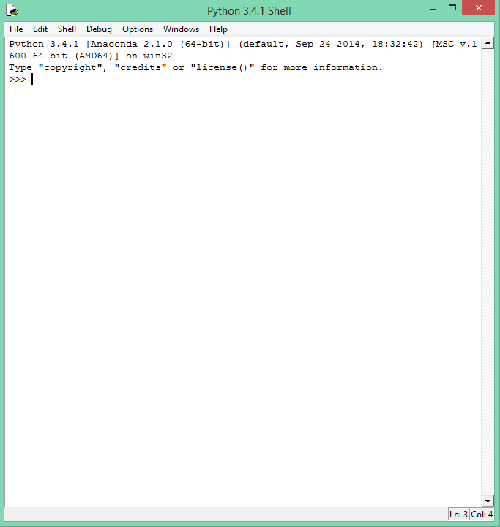
Python IDEs
Built in – IDLE

Slide 15
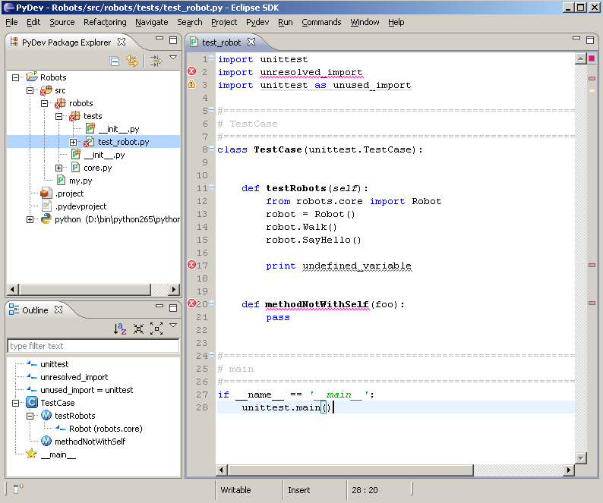
Python IDEs
Pydev for Eclipse
PyDev's Official Site:
http://pydev.org/

Slide 16
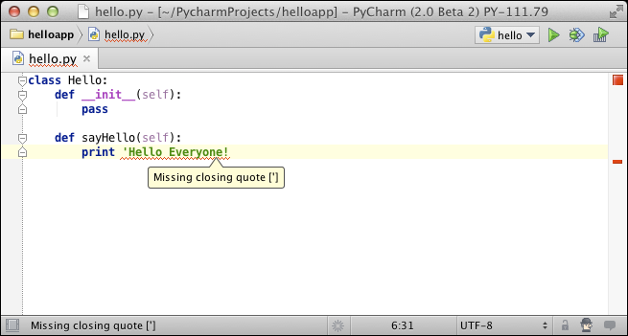
Python IDEs
Pycharm from JetBrains
PyCharm's Official Site:
http://www.jetbrains.com/pycharm/

Slide 17
Demo and Assignment
Download Python
Download an IDE(s) try one
Run the following program

Slide 18
Demo and Assignment
Assignment: set up your python development environment and run the following code the calculate the fibonaci series. Bonus, make it take user input.
def fib(n):
a, b= 0, 1
while a < n:
print (a, end=' ')
a, b = b, a+b
print()
fib(1000)
Notes:
Answer:
def fib(n): a, b= 0, 1 while a < n: print (a, end=' ') a, b = b, a+b print() fib(1000) print( "Hello, World!") max = int(input("Enter a max to compute?")) fib(max)

